Slide 1

E-Police Connect System
Group members
1)Gillian Pereira (250245920030)​
2)Anurag Kamble (250245920017)​
3)Omkar Marne (250245920051)​
4)Om Kauthe (250245920058)

Slide 2

Introduction to E-Police Connect System
This project, the E-Police Connectivity System, aims to provide a change on how police stations handle crucial data. Our system provides a platform for citizens to easily file complaints and track their status online. For designated police officers, it offers secure access to criminal records, prison records, and incident reports, ensuring all vital information is centrally managed and readily available. This digital approach enhances transparency, speeds up operations, and improves overall law enforcement capabilities within the region.​

Slide 3
Problem Definition
In many regions, traditional policing systems face challenges such as delayed incident reporting, lack of real-time communication, inefficient case tracking, and limited citizen-police interaction. This results in slower response times, reduced public trust, and poor data management.
The E-Police Connect System aims to address these issues by creating a centralized, digital platform that facilitates seamless communication between citizens and law enforcement agencies.

Slide 4
System Requirements
Meeting these requirements ensures a reliable, secure, and efficient system for all law enforcement personnel.
Hardware Needs
Operating System (OS): Windows 10 Pro / Windows 11 Pro(64-bit)​
Storage: A 512GB SSD (Solid State Drive)
A minimum of 4GB RAM is essential ​
Software Specifications
React 18+
Microsoft SQL Server (Database) 2022 ​
.NET (Backend)​
Initial deployment might require at least 4-8GB RAM for a small to medium database
Deployment on AWS EC2​
.

Slide 5
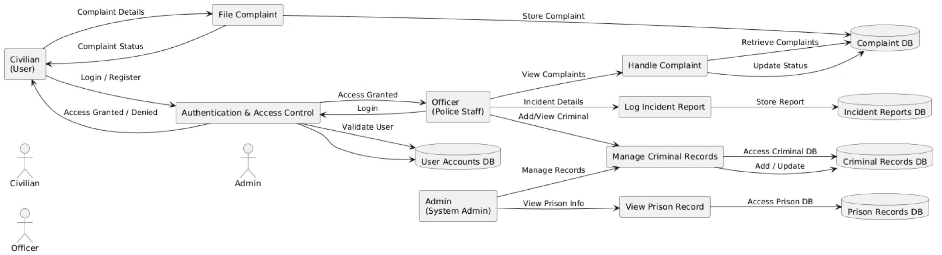
UML Diagram: Core Modules

Slide 6
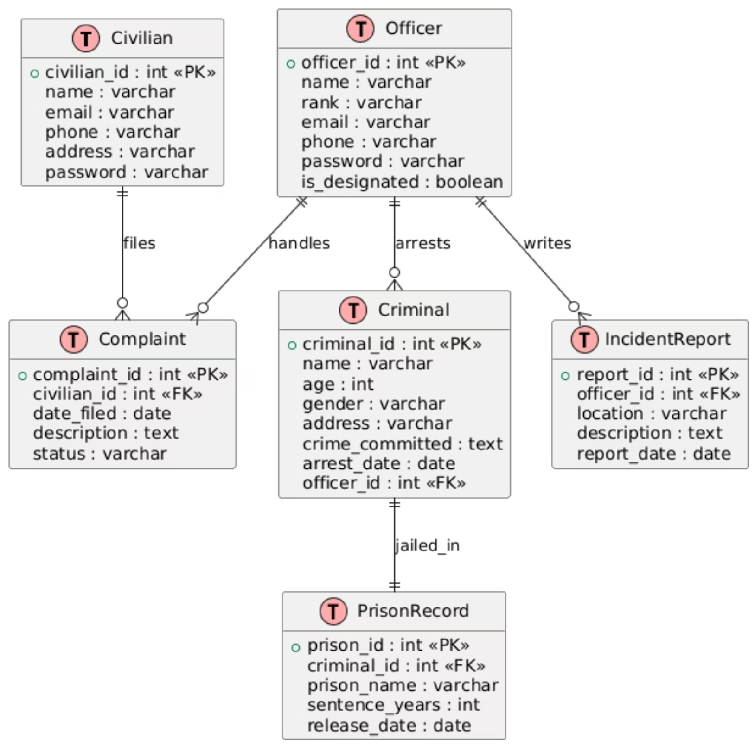
Entity-Relationship (ER) Diagram

Slide 7
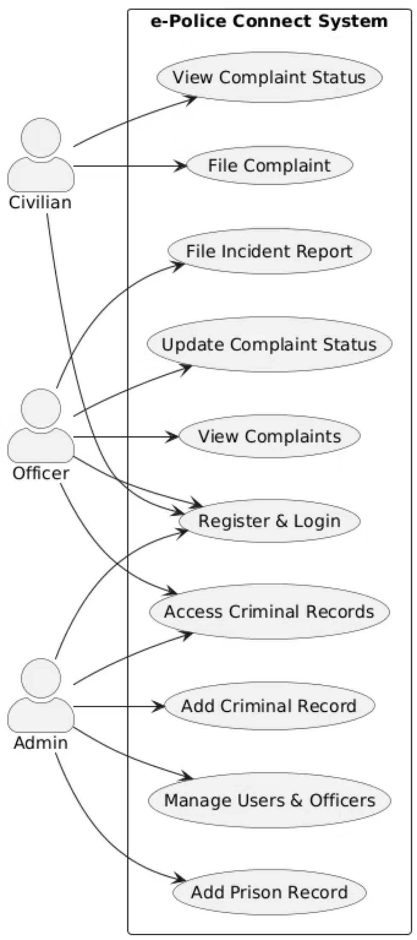
Use Case Diagram

Slide 8
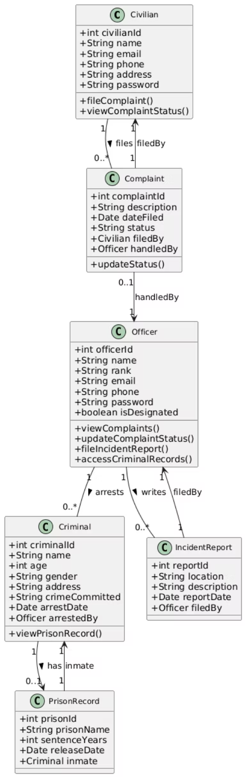
Class Diagram

Slide 9
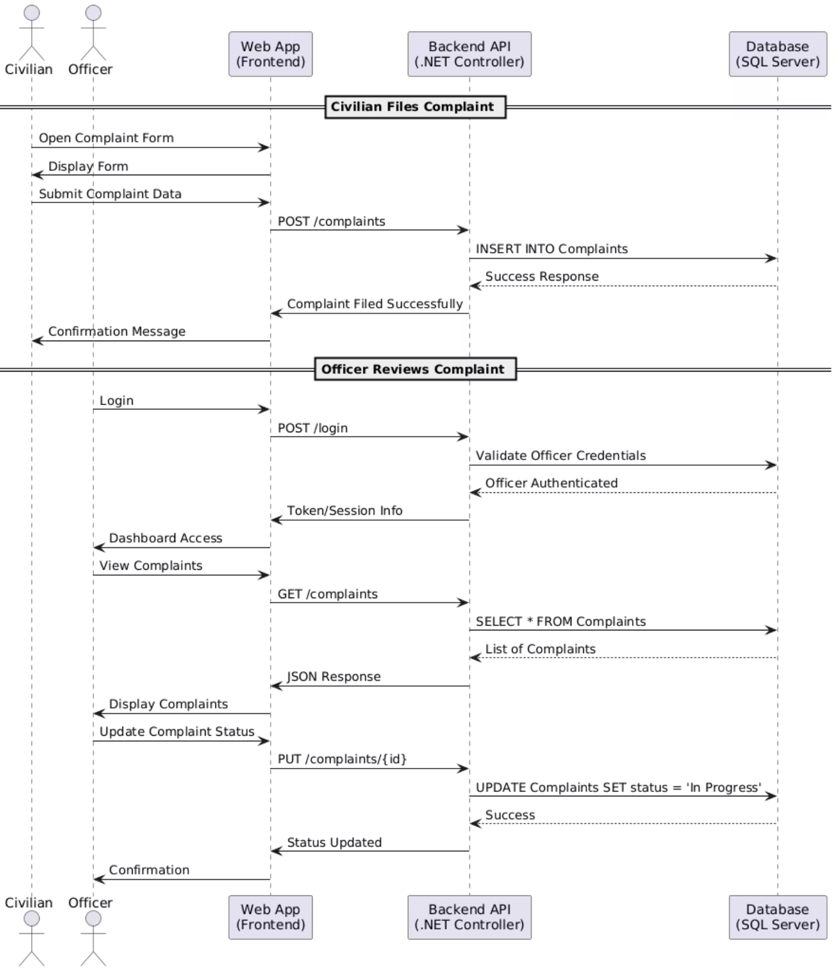
Sequence Diagram: Incident Reporting

Slide 10
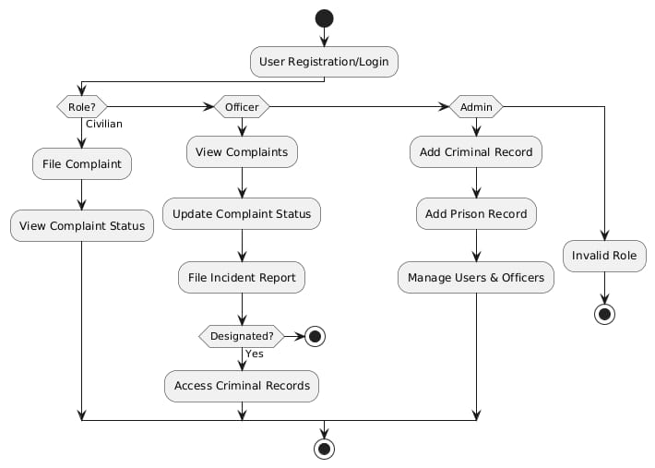
Activity Flow Diagram

Slide 11
THANK YOU

